Slide 1
Registration and App Hosting Guidelines
Apps.mgov.gov.in

Slide 2
Click on- “Developer Portal”
Notes:
Content Slide: This is usually the most frequently used slide in every presentation.
Use this slide for Text heavy slides. Text can only be used in bullet points
Title Heading – font size 30, Arial Heading
Slide Content – Should not reduce beyond Arial body font 16
If you need to use sub bullets please use the indent buttons located next to the bullets buttons in the tool bar and this will automatically provide you with the second, third, fourth & fifth level bullet styles and font sizes
Please note you can also press the tab key to create the different levels of bulleted content

Slide 3
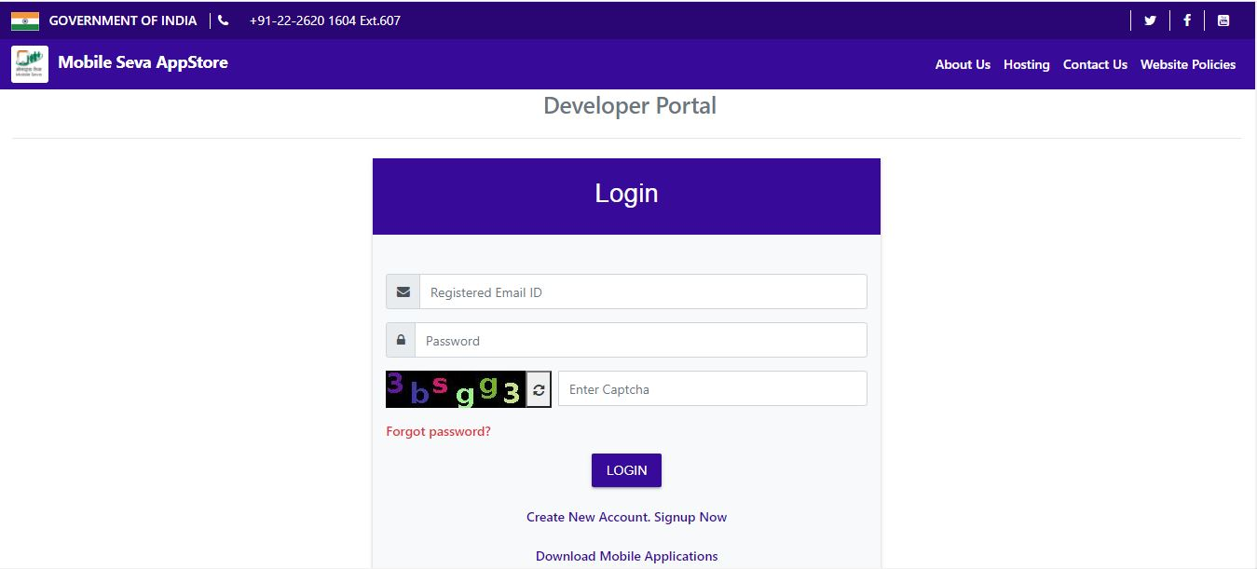
Registration and Login
Registration Link
Citizen Portal Link
Notes:
Content Slide: This is usually the most frequently used slide in every presentation.
Use this slide for Text heavy slides. Text can only be used in bullet points
Title Heading – font size 30, Arial Heading
Slide Content – Should not reduce beyond Arial body font 16
If you need to use sub bullets please use the indent buttons located next to the bullets buttons in the tool bar and this will automatically provide you with the second, third, fourth & fifth level bullet styles and font sizes
Please note you can also press the tab key to create the different levels of bulleted content

Slide 4
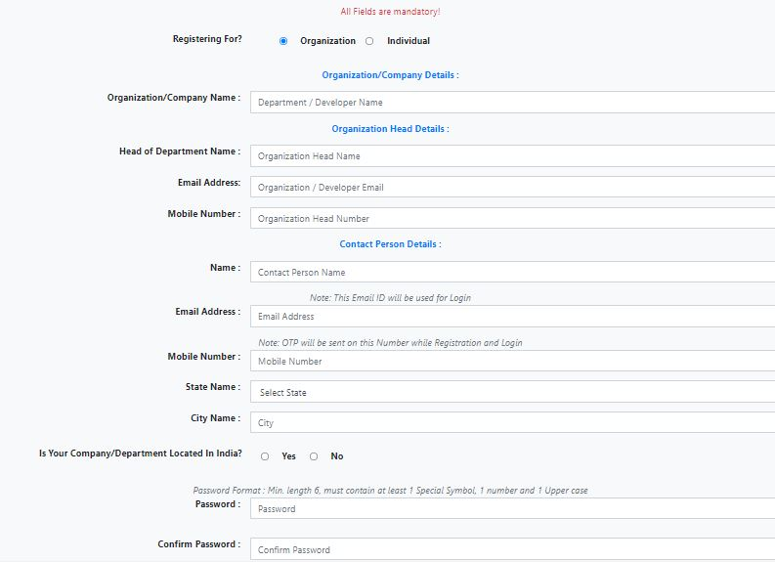
Enter Registration Details (Organization)
Notes:
Content Slide: This is usually the most frequently used slide in every presentation.
Use this slide for Text heavy slides. Text can only be used in bullet points
Title Heading – font size 30, Arial Heading
Slide Content – Should not reduce beyond Arial body font 16
If you need to use sub bullets please use the indent buttons located next to the bullets buttons in the tool bar and this will automatically provide you with the second, third, fourth & fifth level bullet styles and font sizes
Please note you can also press the tab key to create the different levels of bulleted content

Slide 5
Enter Registration Details (Individual)

Slide 6
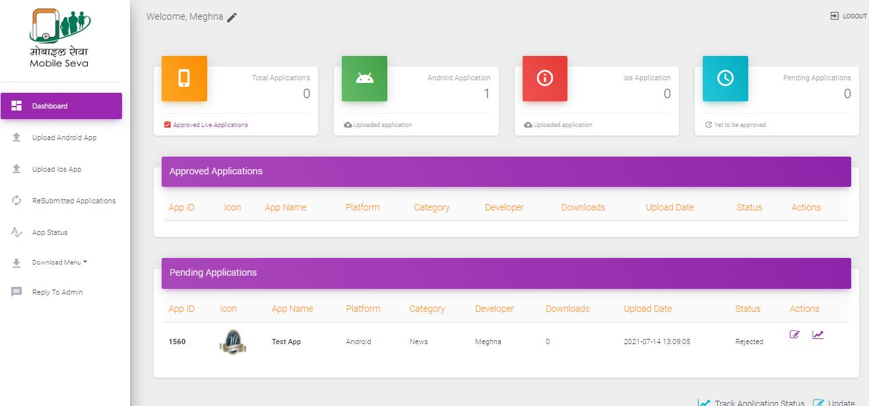
Developer Dashboard (After Account approval by Admin & login by user)
Notes:
Content Slide: This is usually the most frequently used slide in every presentation.
Use this slide for Text heavy slides. Text can only be used in bullet points
Title Heading – font size 30, Arial Heading
Slide Content – Should not reduce beyond Arial body font 16
If you need to use sub bullets please use the indent buttons located next to the bullets buttons in the tool bar and this will automatically provide you with the second, third, fourth & fifth level bullet styles and font sizes
Please note you can also press the tab key to create the different levels of bulleted content

Slide 7
App Hosting Guideline
How to upload Android App

Slide 9
Prerequisite
App Icon | Format : PNG/JPG, Size : 512x512 px and less than 200 kb
APK file | Format: .apk , Max Size : 90 Mb

Slide 10
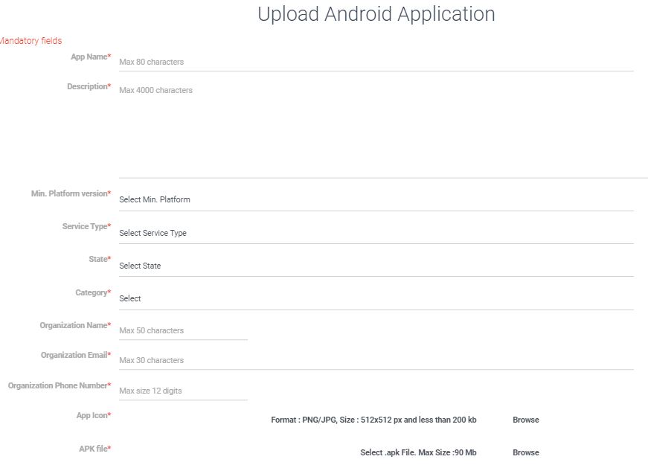
Upload Android Form

Slide 11
Be ready with permission related questions
Is your App developed in India?
Does your App uses personal data?
Does your App support any ad services?
Does this App has any functionality associated with financial activities ( i.e Invoking financial transaction through app )
Is your app suitable for children?
Does your App use LOCATION group permissions? If “Yes” describe the functionality associated with the permissions
Does your app use CAMERA group permissions? If “Yes” describe the functionality associated with the permissions
Does your app use CONTACTS/CALL_LOGS group permissions? If “Yes” describe the functionality associated with the permissions
Does your app use MICROPHONE group permissions? If “Yes” describe the functionality associated with the permissions
Does your app use STORAGE group permissions? If “Yes” describe the functionality associated with the permissions
Does your app use User Authentication? If “Yes” please provide one dummy login password

Slide 12
Click on Undertaking

Slide 13
Read terms and condition carefully

Slide 14
Accept all terms and Upload

Slide 15
Upload Successful Page

Slide 16
Testing Process
Uploaded apps will undergo testing process with CDAC team.
Reports will be shared with app team if any vulnerabilities will be forund.
After approval from testing team, app will be hosted on Appstore.

Slide 17
For AppStore Support , Contact
Email : apps@cdac.in
Phone: +91-22-26201606 Ext.587/607, +91-8657515545.

Slide 18
Thank you
Notes:
Thank you slide with customer logo
Thank you slide with the customer logo:
Should have only the details shown here. Logo placement cannot be changed. Wipro logo to appear on the left as per our corporate guidelines.
Thank you– font size 30, Arial Headings
Name & Designation – font size 18, Arial Headings, not to exceed beyond 2 lines
Your/contact email id – font size 18, Arial Headings

